Slide 1
LENOVO SALES FORECASTING
Raghu Murugankutty

Slide 2
TABLE OF CONTENTS
Problem statement
Objective
Importing libraries and Basic data preprocessing
Normalizing the anomalies
Checking Stationarity using Dickey-Fuller test and Rolling-statistics
Making series stationary
Decomposition and Differencing
Fitting and predicting
Auto Arima
Conclusion

Slide 3
PROBLEM STATEMENT
Create a forecast for what the visits would look like for the next year based on the historic data points from the ‘Data for Forecast’
Consider seasonality and normalize the anomalies.

Slide 4
OBJECTIVE
Time series forecasting Consider seasonality and normalize the anomalies.

Slide 5
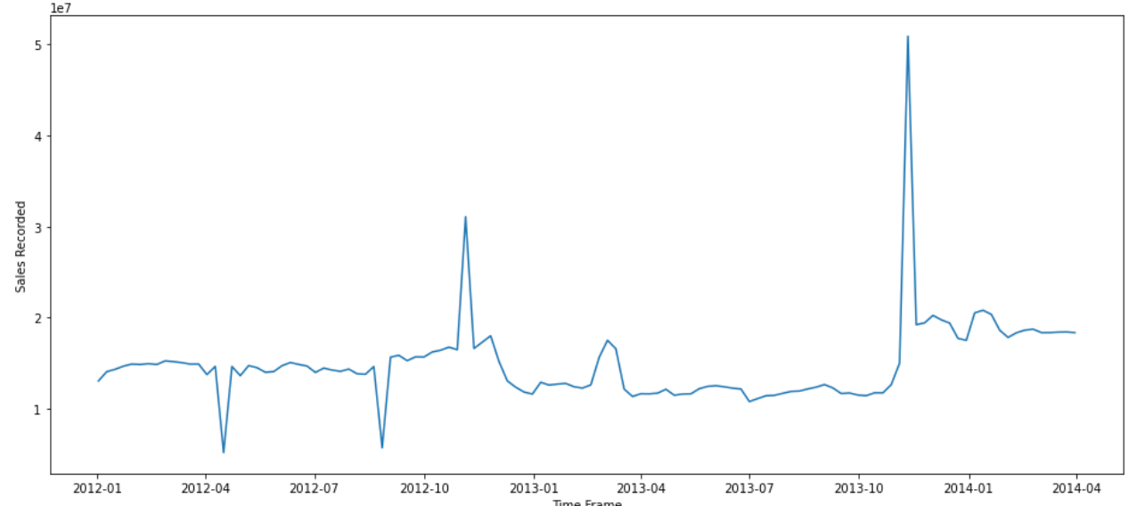
PLOTTING THE DATA

Slide 6
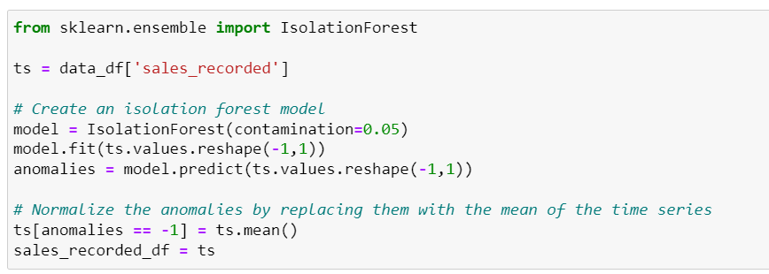
NORMALIZING THE ANOMALIES
Using IsolationForest module for anomaly detection in a dataset

Slide 7
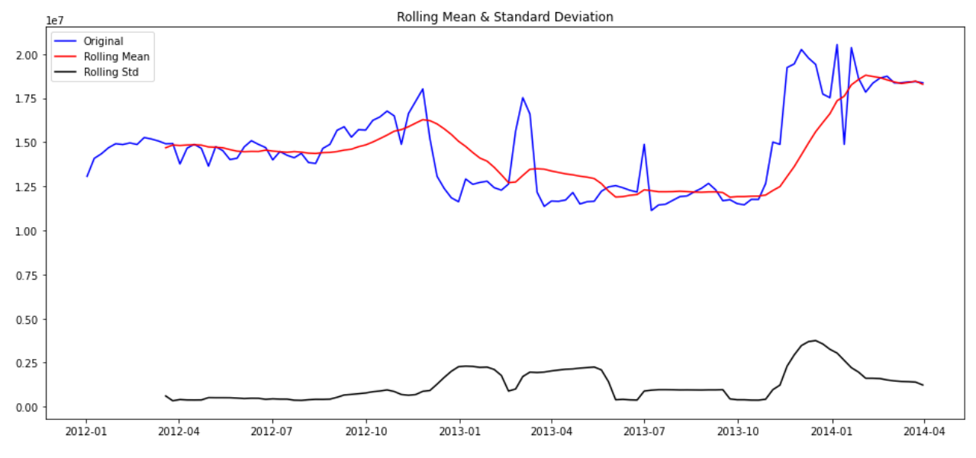
CHECKING STATIONARITY
Checking stationarity using Rolling statistics and Dickey-fuller tests

Slide 8
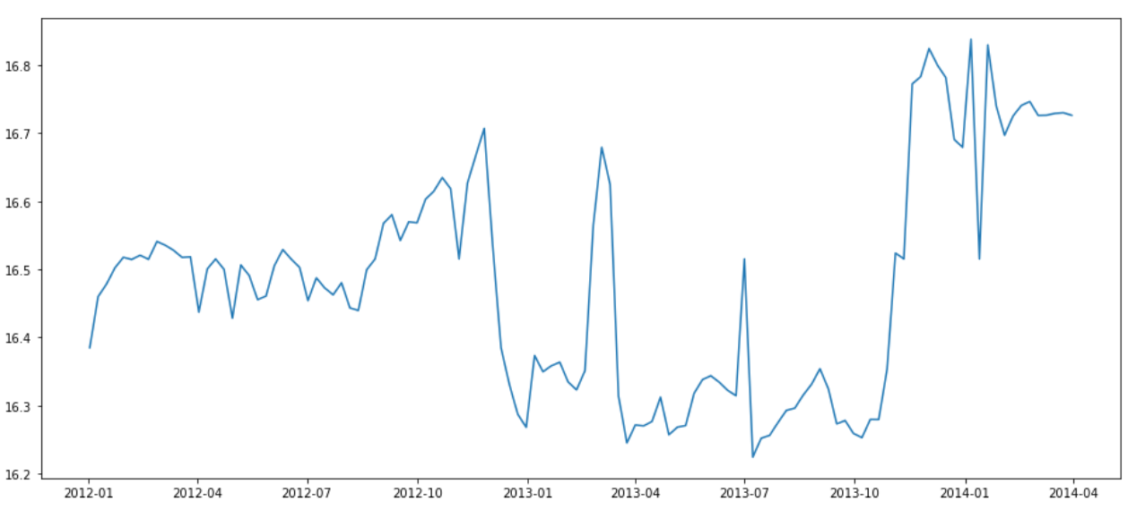
SERIES AFTER LOG TRANSFORMATION
making series stationary using log transformation

Slide 9
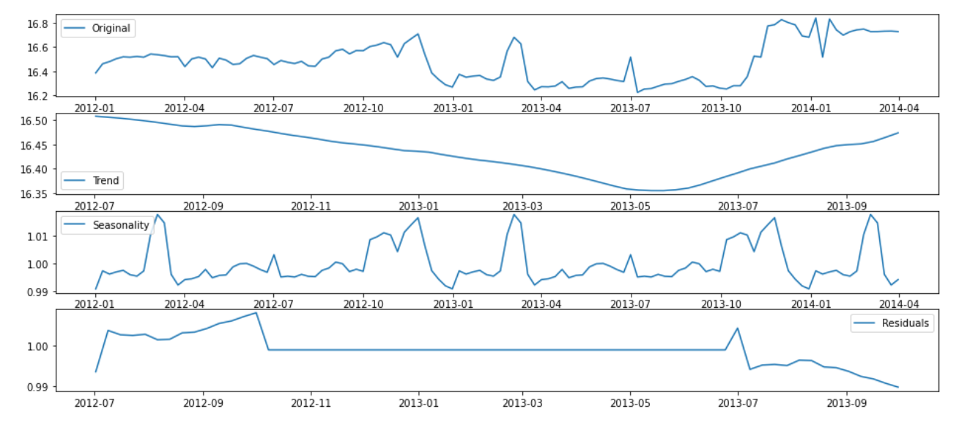
DECOMPOSED SERIES
Decomposing the series using seasonal_decompose

Slide 10
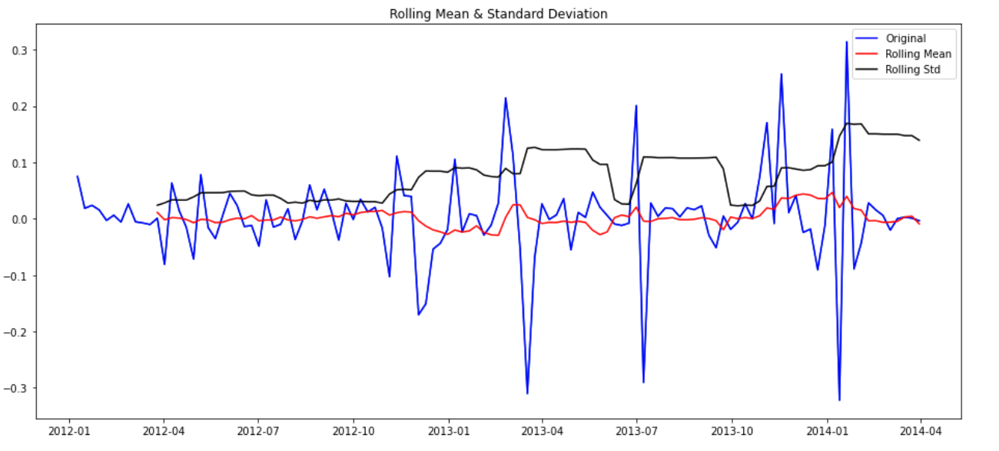
DIFFERENCING
Applying Differencing to make time series stationary

Slide 11
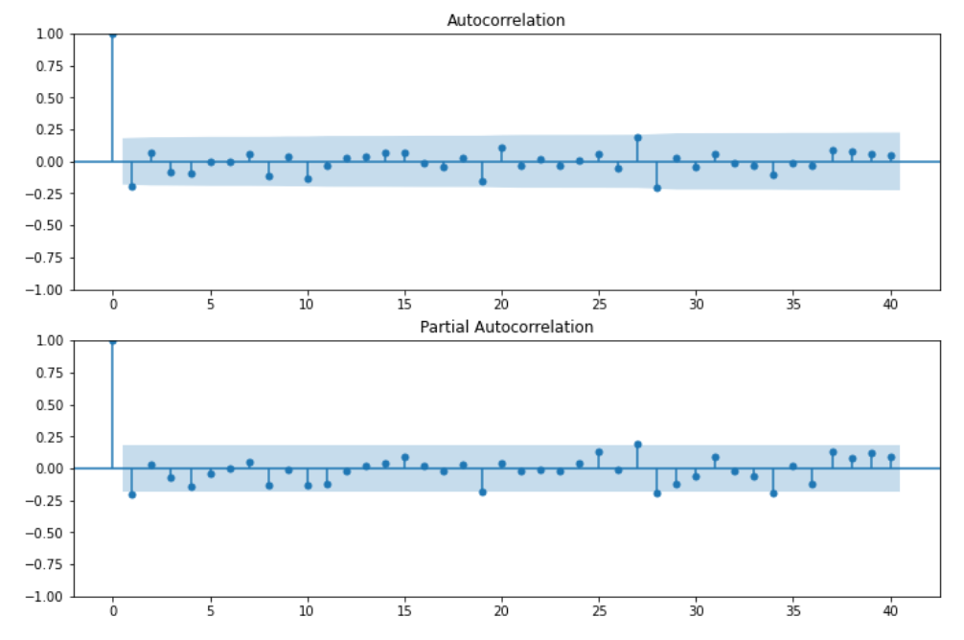
ACF & PACF
Applying ACF (Autocorrelation Function) and PACF (Partial Autocorrelation Function) used tools in time series analysis for identifying patterns in the data.

Slide 12
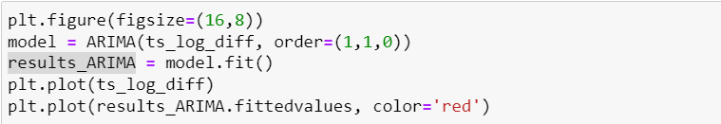
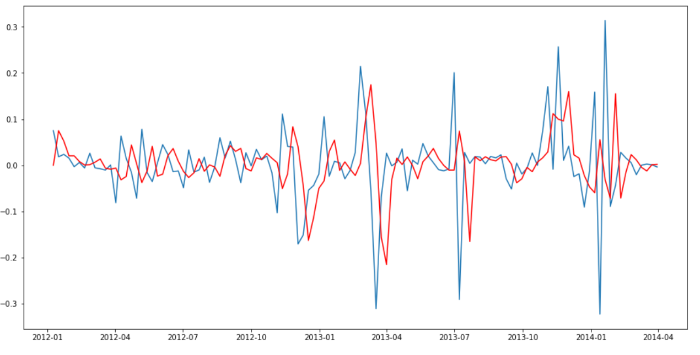
ESTIMATING THE PARAMETERS

Slide 13
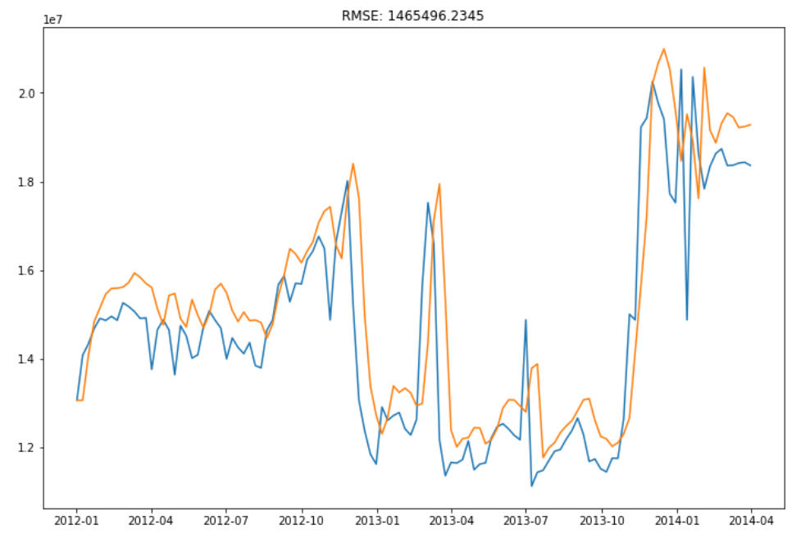
MODEL EVALUATION
The model's performance, as measured by the RMSE score of 1465496

Slide 14
CONCLUSION
The model's performance, as measured by the RMSE score of 1465496, has room for improvement in its ability to accurately estimate the parameters.

